Slide 1
Feedback on the ECA Mobile Statistical Platform presentation
African Centre for Statistics
ECA Mobile Statistical Platform

Slide 2
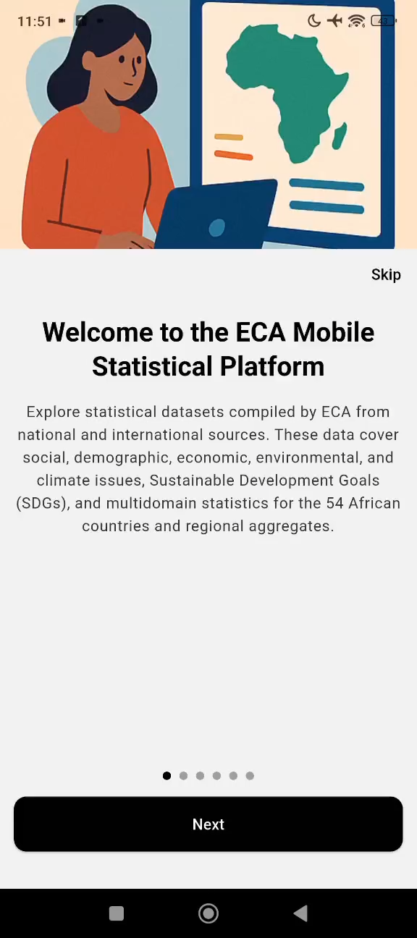
Key features
Executive Statistics: Provides aggregated socio-economic indicators for Africa and its subregions, including SDGs.
Statistical Portal: Offers detailed country profiles, SDGs, Agenda 2063, and other thematic areas like health, agriculture, energy, and more;
Tracking SDGs: Analytical SDGs progress report
Search Indicators: Helps to find specific indicators from ECAStats portal.
Notes:
I will be providing you a very quick update on the feedbacks of the Mobile Statistics Platform
Just a reminder:
This app has the following features
Executive Statistics
Provides aggregated socio-economic indicators for Africa, sub-regions, including SDGs
Statistical portal
Data products and Dashboard
Search Functionality

Slide 3
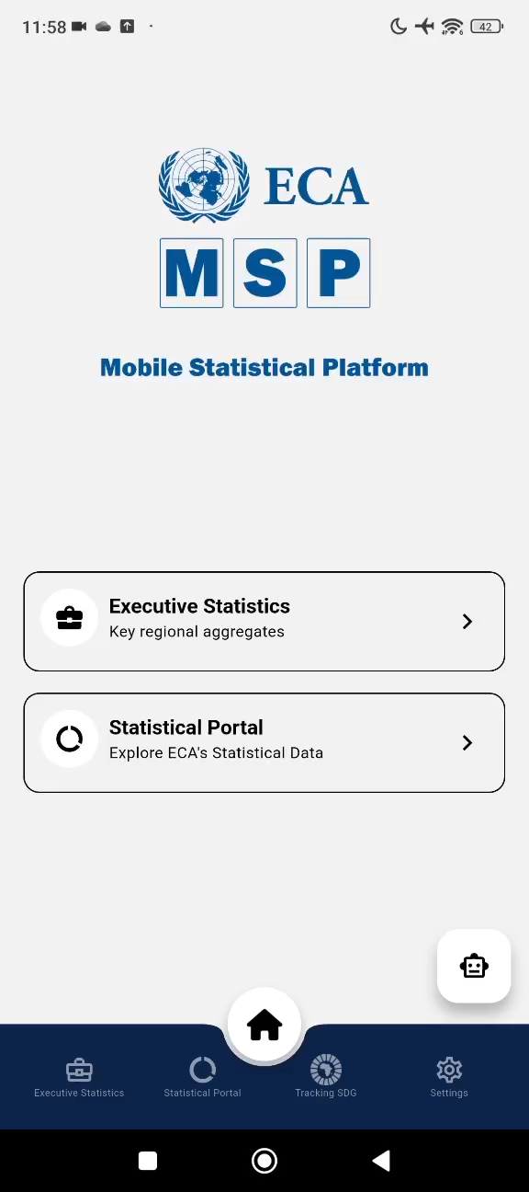
Key features
Settings to changes look and feel to suit users preferred light or dark mode
Data update: The app can be refreshed, allowing users to access the latest data and new features as soon as they are available.
Offline access: Allow users to use even without an internet connection.
Notes:
A quick recap on what we are currently testing
The App is dynamic and
- Up to data
- Offline Accessible

Slide 4
Steps
Gathering feedbacks
Gathering user feedback (app can be installed on android phones currently);
Testing
Testing functionality and performance;
Optimizing
Optimizing performance (including on-demand data saving for offline use);
Publishing
Publishing the app on both the App Store and Google Play (currently working with ICTSS).
Notes:
We are following the steps displayed
Here
Gathering feedback
Testing, currently only on android devices
Optimizing, New Features and (on demand download for offline access based on user feedback)
Publishing
ICTSS organizing the publication of the apps on both apple store and play store

Slide 5
Testing
ICTSS Created an app distribution for iOS and Android testing
Invited ECA staff (All divisions, SROs, IDEP)
# of users accepted – 30 plus
ITSS managed to secure access for iOS testing
The app is submitted to Appstore
Notes:
Internal Testing is on track,
Beta testing:
Wider group
So far, we have 20 Users testing the application
1.8 sessions
On average it is taking 6 minutes
Also, we have been able to test across 5 android
From android 9 to 15
To increase our beta testers, we are actively seeking Professionals from the SRO’s
So far we have contacted

