Slide 1
Subprogramme 4: Data and Statistics
Accountability and Programme Performance Review Meeting
Year End Programme Status Report for 2025
Theme: “Sustaining gains: Taking stock of Results in 2025 and Planning for Strategic Impact in 2026”
8 – 12 December 2025

Slide 2







Overview of subprogramme work in 2025
46 Countries Reached
Target audience
CoF: Botswana, Burkina Faso, Burundi, Côte d’Ivoire, Democratic Republic of Congo, Egypt, Equatorial Guinea, Ethiopia, Ghana, Kenya, Liberia, Libya, Malawi, Mozambique, Nigeria, Rwanda, Senegal, Somalia, South Africa, Zimbabwe
Other: Angola, Benin, Cabo Verde, Cameroon, Central African Republic, Chad, Djibouti, Eritrea, Gabon, The Gambia, Guinea-Bissau, Lesotho, Mali, Mauritius, Namibia, Seychelles, Sierra Leone, South Sudan, Sudan, Tanzania, Togo, Uganda, Zambia
4
National Mapping Agencies
1485
Data and Statistical Experts
Towards integrated Geospatial information framework
43
National Statistical Office
Towards digital transformation and modernization of statistical systems
Capacities Developed
Data Governance Assessment Framework and tools (South Sudan).
Methodological skills in agro-pastoral index (Burundi).
Methodological skills in Turnover Index (Cameroon).
skills in census methodology, planning, geospatial mapping, and digital data management.
Analytical skills in survey data with Earth Observation data for small area estimation
Changes Observed
South Sudan: Developed a national CRVS Strategic Plan.
Cameroon: Produced a Turnover Index using administrative data sources.
Sierra Leone and Lesotho: Strengthened preparedness for the 2026 Census.
Regional Capacity: Enhanced national skills in Small Area Estimation (SAE) using R and geospatial tools.
Advisory Service
Capacity Building
Members of ECA produce and disseminate comparable economic statistics
Digital Materials
Improved CRVS System
1
Notes:
Speaking points for the DES.
The African Centre for Statistics under SP4 is contributing to the objective of production, dissemination and use of credible data, statistics and geospatial information at the national, regional and global levels for evidence-based policy and decision-making. In the reporting quarter, the SP reached 16 countries with various data and statistical technical, advisory and capacity building supports. The SP provided advisory services for Cameroon, Mali, Burundi, and Rwanda on integrated geospatial information framework that resulted in the development of Country Action Plan and incorporated it in their national polices and strategies. Tailed made capacity building training were provided to data experts and statisticians in Nigeria, Malawi, Uganda and Namibia with the aim of modernizing the vital statistical production process using the R method. The technical knowledge and skill of the National Statistical Offices of the respective countries in the production and utilization of CRVS process using R method improved. The technical support to modernize the Census Monitoring tools and Dashboard improved the survey process utilization and the application of up-to-date survey monitoring services in Angola, Benin and Burundi. The SP organized consultation workshop to enrich the content of the Draft E-Census handbook and pertinent insights were incorporated to expand on a digital census business model through increased use of technological and methodological innovations. Ongoing technical advisory support on Economic Accounting were provided. Participants, including statisticians and data experts from various National Statistical Offices (NSOs), capacitated their skills how AI-driven technologies can streamline operations, improve data accessibility, and automate complex tasks. The technical support provided practical examples of how African NSOs could integrate AI into their work, reducing manual processes and advancing their capacity for innovative data analysis. The event highlighted the transformative potential of generative AI for modern statistical practices and set the stage for future discussions on this cutting-edge topic. The SP is supporting Eritrea with Economic Accounting data sets including updating macro-economic statistics and data. Ongoing activities including online update of price watch data along with other corresponding data sets is in progress. ECA is designated as data verification client for the East African Community Programme (EAC). In the reporting quarter ACS provided verification support on broad data sets including geospatial information, economic and demographic statistics indicators to National Statistical Offices of Kenya, Rwanda and Tanzania. The verification process was followed by compiling and submitting reports to the World Bank which resulted in access to Disbursement Fund for the member states.

Slide 3
8
Result Area: Improved CRVS system performance ________________________________________________________________________________
What
Accelerated reporting of vital events, enabling timely availability of up-to-date statistics for policymakers and stakeholders
Applied modernized data and statistical processing systems.
Training on Data management on national administrative individual records and datasets
Training for 6 data experts on output- input tables for writing a vital statistics report using R
Reduced CRVS report generation timing
How
Where
Namibia
Evidence
namibia

Slide 4
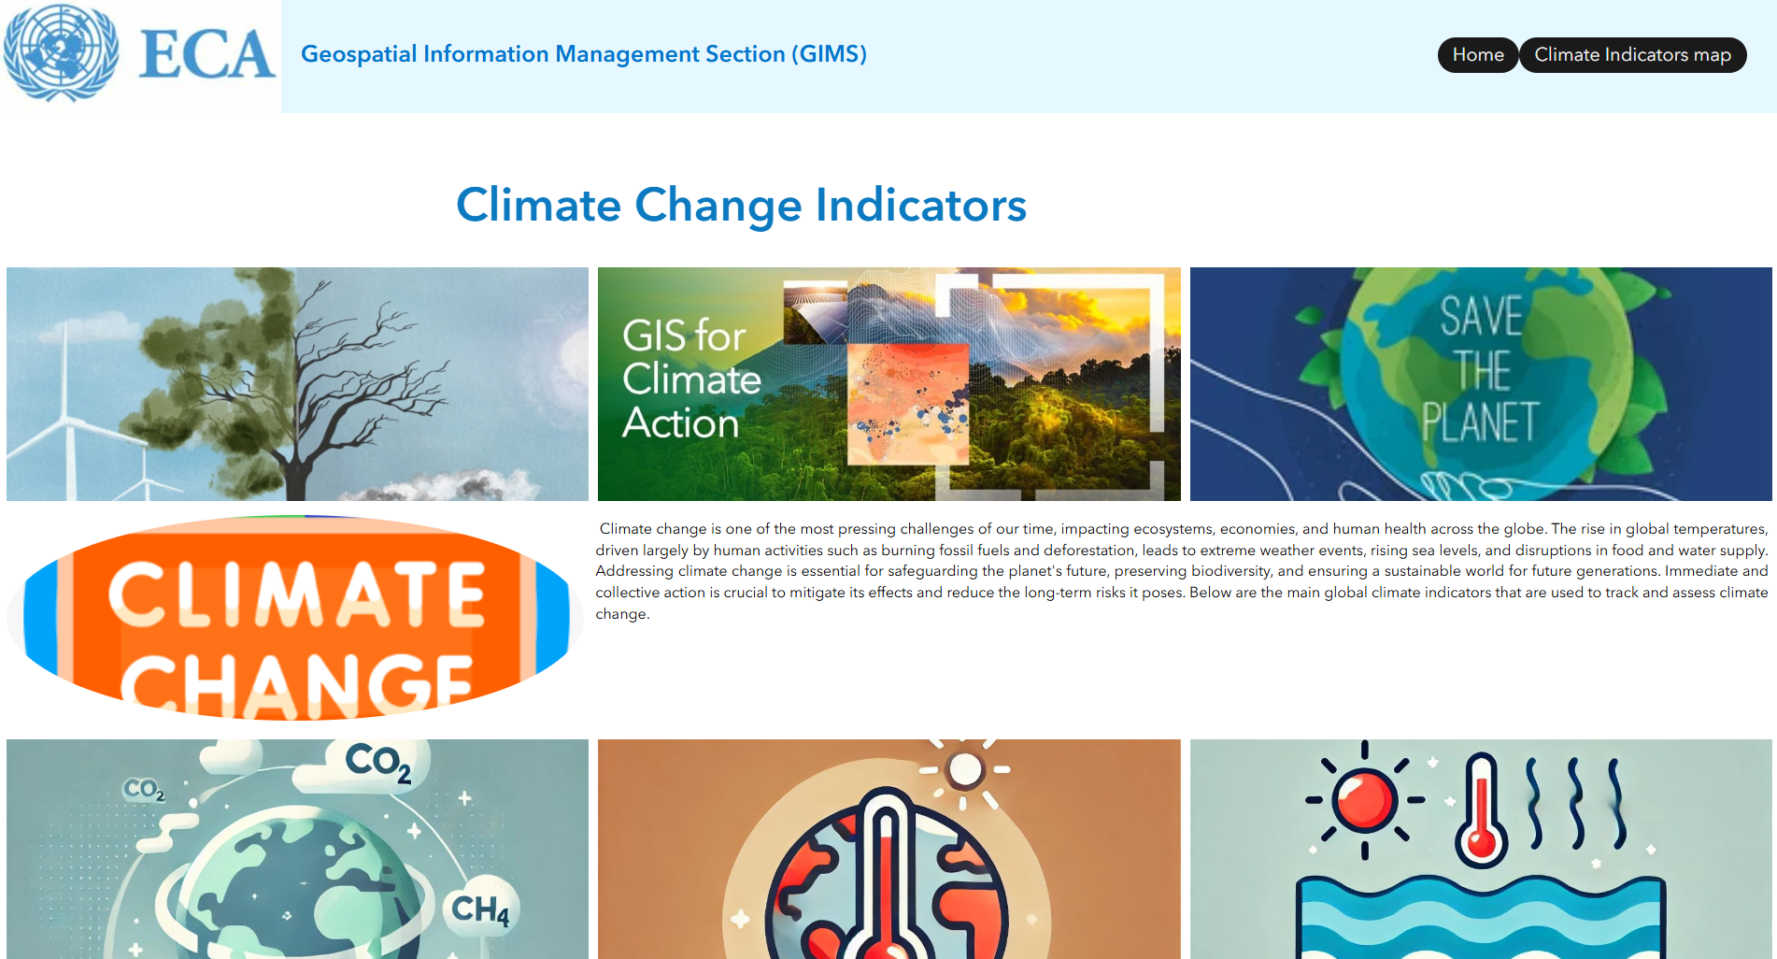
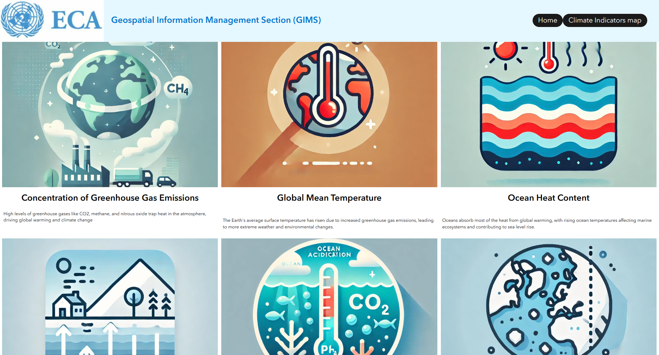
8
Result Area: Progress towards Integrated Statistical and Geospatial Information Frameworks ________________________________________________________________________________
What
Enhancing national data ecosystems towards systematic climate and disaster‑risk monitoring and reporting
Research: Technical review of existing geospatial data initiatives to define the set of essential climate variables informing the design of the tool.
Consultations: Targeted consultations with member States (Burundi, Namibia) to validate priority indicators, data sources.
Review: Experts in climate-related statistics and geospatial analysis were reviewed the identified priority indicators.
Testing: Internal pilot testing assessed performance in operational settings.
Training: Capacity‑building of national data ecosystem custodians, including staff from NSOs, NMAs, climate, environment and disaster ministries on practical use of the tool, interpretation of the climate indicators, and integration of outputs into national climate and disaster‑risk monitoring systems
How
Where
Evidence
Africa
Climate Change Indicator Map

Slide 5





5
Contribution to Sustainable Development Goals
__________________________________________________________________________________________________________________
SDG
SDG Target
SP Contribution
Budget expenditure
17.18, 17.19
Technical support and capacity building for in Statistical and Data Exchange system in SDGs reporting and monitoring
Capacity building in statistical leadership
Advisory technical support in data harmonization
Advisory and capacity building in modernization and use of administrative data sources
$2,723,662
16.6; 16.9;16.10
Technical support in rebasing of GDP in Togo Eritrea and Burkina Faso
Technical advisory services in the use of the Environmental Economic Accounting Framework
Technical advisory support in the use of African Continental Output Input Table
$ 244,956
8.1;8.9
Advisory and capacity building support in 3 countries in the Integrated Geospatial Information Systems and African Geodetic Reference Framework
Update of geoportals and data sets in Geospatial Information
Capacity building supporting in development of National Action Plan on Geospatial information
9.1;9.C
$ 160,652
11.3
17.19
Technical advisory and capacity building in the use of innovative application in CRVS
Technical Advisory support in digital population and housing censes in three countries
$ 3,722,563
16.6; 16.9;16.10
16.19

Slide 6

5
Cross-cutting issues
________________________________________________________________________________________________________
Analysis in the Flagship publications such as the Africa SDG Progress Report highlighting Unemployment rate, by sex and disability
Capacity development in CRVS to support disability inclusion by providing accurate data to ensure equal access to services
Using CRVS and Admin Data to Close Gender Gaps in Africa.
Mainstreaming gender in CRVS and NSDS through developing Action plan
Analytical work on time use of women spent in domestic works
DISABILITY INCLUSION
GENDER
Advocacy on Webinar on SEEA–Central Framework aligned accounts and how to use these statistics to inform decision making.
Integration of statistical and geospatial information in land and water management enabling sustainable allocation and use
The use of R in CRVS to generate accurate and timely data on legal identity
Support countries In digital censuses to promote human rights by ensuring everyone is counted and included
ENVIRONMENTAL SUSTAINABILITY
HUMAN RIGHTS

Slide 7






11
Reflections
_________________________________________________________________________________________
Implementation Challenges
Lessons
Solutions
Build flexibility into plans to manage delays in resource disbursement.
Increasing resource base with continued engagement in extra- budget resources
Leveraging the existing platforms to Strengthen coordination mechanisms
training modules,
Devise innovative methods and training models to increase access to granular data
Institutionalize continuous capacity-building programs, including on-the-job mentoring and online
Insufficient and delayed disbursement of resources, affecting timely implementation of planned activities
Proactive planning and risk management is vital during resource constraints and delays
The need to define the role of ECA and AUC in CoM -CRVS
.
Unclear and overlapping institutional roles between ECA and AUC in in CRVS CoM
Analytical and through need assessment is vital to address the core gaps of the countries
.
Challenges of accessing granular data at countries level for survey and geospatial data
The value of combining survey data with Earth Observation data to produce high-resolution estimates for policy and planning
Risk of skill attrition at NSOs due to staff turnover and limited continuous training opportunities
Strengthen the continuous engagement with countries is vital to enhance program implementation

Slide 8

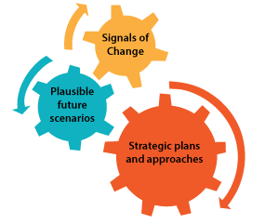
7
New evidence for analysis
_________________________________________________________________________________________
1. Regional Harmonization and Interoperability
Signal: Growing need for cross-country comparability and regional reporting (AU, REC, SDG, and international obligations).
Emerging Work:
  Harmonizing statistical standards, methodologies, and classifications across Africa.
  Facilitating interoperability of national systems with regional data platforms.
  Supporting regional statistical initiatives and peer learning among NSOs.
  Designing regional DPI architecture to support interoperability of NSO, CRVS,
2. Climate, Environment, and Sustainable Development Statistics
Signal: Increasing demand for climate resilience, environmental monitoring, and SDG-linked indicators.
Emerging Work:
  Developing climate and environment statistics frameworks (land use, water, emissions, biodiversity).
  Integrating environmental, socio-economic, and geospatial data for SDG 13, SDG 6, SDG 15 monitoring.
  Supporting countries in climate finance monitoring and reporting.

Slide 9


