Slide 1
Capacity Building for Gender Statistics and Monitoring Systems (CB-GenSMS) Project
MULTINATIONAL – Burundi, Mozambique, South Sudan, and Zimbabwe
Appraisal Mission 5-13 October 2021

Slide 2
Outline of the presentation
Mission Objectives
Overview of Mission Program
Project justification, objectives, and components
Overview of the state of play on Gender Statistics key programs (ongoing and planned) and identify the critical capacity gaps (UNECA)
Deep Dive on project component 1 (Gender Statistics)
Deep Dive on project component 2 (Monitoring Systems)
Project Results Framework, Budget estimated and allocation

Slide 3
Mission Objectives
The purpose of the mission is to appraise the Capacity Building for Gender Statistics and Monitoring Systems (CB-GenSMS) Project
This is to undertake consultations with relevant officials at the UNECA and other key stakeholders and partners, in order to collect data and information to enable the preparation of a Project Appraisal Report for CB-GenSMS Project

Slide 4
Overview of Mission Program
Mission program

Slide 5
PROJECT JUSTIFICATION
Compiling gender statistics for Africa Regional Members States (RMC) is essential to meeting the urgent need for reliable and timely data to help in the formulation and further refining of gender-responsive Poverty Reduction Strategies. Gender statistics are key for inclusive national development planning.
Unfortunately, almost all African countries are facing challenges in producing and disseminating robust gender statistics.

Slide 6
GENDER STATISTICS CHALLENGES IN AFRICA
Lack of an enabling environment, including poor legal frameworks and a weak policy environment
Lack of Domestic financial resources for gender statistics
Poor coordination Mechanism
Lack of harmonization of concepts, definitions and methodologies as well as poor technical capacities
Data accessibility, including poor open data policies and programmes
Lack of gender-specific surveys
Poor integration of gender statistics into ongoing statistics work; poor administrative records; and ineffective and outdated dissemination approaches

Slide 7
PROJECT OBJECTIVES
Addressing these challenges is key in encouraging policy and strategy debates or dialogues that respond to gender inequalities and also capture good practices for inclusive national development planning.
The Project aims to contribute to improved gender responsive programming by beneficiary countries, therefore contributing to inclusive development
It will contribute to addressing inequality and fostering inclusive growth by providing data on the “invisible” and most vulnerable, which are often drivers on fragility.

Slide 8
PROJECT OBJECTIVES AND COMPONENTS
To Improve the availability of gender statistics in transition states/ countries, that provide a foundation for inclusive national development planning.
OUTCOMES
The statistical systems of the beneficiary countries produce quality, comparable and regular gender statistics to address national data gaps and meet policy and reporting commitments under the SDGs
Monitoring and reporting mechanisms of the beneficiary countries integrate gender indicators across sectors
OUTPUTS
The capacity of national bureaus of statistics to collect, interpret and disseminate gender statistics is strengthened
Increased availability of gender-related knowledge products on transition countries
PURPOSE
Capacity Building for Gender Statistics
Development of National Gender Monitoring Systems
COMPONENT 1
COMPONENT 2

Slide 9
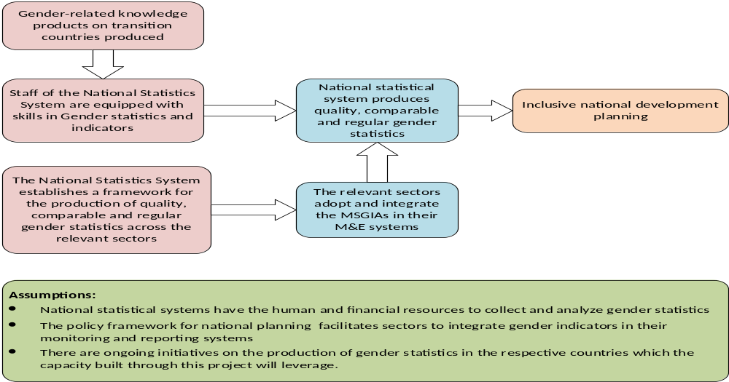
strategic expectations of the project

Slide 10
UNECA GENDER STATISTICS PROGRAMME (to be completed by uneca)

Slide 11
DEEP DIVE ON PROJECT COMPONENT 1
(CAPACITY BUILDING FOR GENDER STATISTICS)

